Slide 1

Capstone Project 4
Netflix Movie and TV Show Clustering
Individual project
Name- Harshad Savle
Email- harshad.savle@gmail.com

Slide 2
Contents
Problem statement
Understanding data
Exploratory data analysis
Data Cleaning
Textual Data preprocessing
Clusters implementation
Build Recommendation System
Conclusions

Slide 3

Problem Statement:
Netflix is the world's largest online streaming service provider, with over 220 million subscribers as of 2022-Q2. It is crucial that they effectively cluster the shows that are hosted on their platform in order to enhance the user experience, thereby preventing subscriber churn.
We will be able to understand the shows that are similar to each other and different from one another by creating clusters, which may be leveraged to offer the consumers personalized show suggestions depending on their preferences.
Project Goal:
The goal of this project is to classify/group the Netflix shows into certain clusters such that movie and TV shows that are in the same cluster/group should have similar properties and/or features, while data points in different groups should have highly dissimilar properties and/or features.

Slide 4
DATA PIPELINE:
Analyze Data: In this initial step we went to look for different features available and tried to understand the data. During this stage, we looked for the shape of data, data types of each feature, statistical summary etc.
EDA: EDA or Exploratory Data Analysis is the critical process of performing the initial investigation on the data. So, through this we have observed certain trends and dependencies and drawn certain conclusions from the dataset that will be useful for further processing.
Data Cleaning: Checked duplicated values present in the dataset. After that comes the null value and outlier detection and treatment. For the null values imputation we simply replace with empty string and drop some of the null rows then analyze outlier and handling.
Textual Data Preprocessing: During this stage, cluster the data based on the attributes: director, cast, country, genre, rating and description. Data preprocessing include Remove all stop words and punctuation marks, convert all textual data to lowercase. Stemming to generate a meaningful word out of corpus of words. Tokenization of corpus and Word vectorization. We used Principal Component Analysis (PCA) to handle the curse of dimensionality.
Clusters Implementation: Use K-Means and Agglomerative Hierarchical clustering algorithms to cluster the movies, obtain the optimal number of clusters using different techniques.
Build Content Based Recommendation System: A content-based recommender system was built using the similarity matrix obtained after using cosine similarity. This recommender system will display 10 recommendations to the user based on the type of movie/show they watched.

Slide 5
ATTRIBUTE INFORMATION:
DATASET SUMMARY:
This dataset consist of movie and TV shows available on Netflix till 2020.
The dataset contained about 7787 records and 12 attributes.
Most of the features are Present in textual format.
Dataset contains two type of content one is Movie and another one is TV show.
Show Id : Unique ID for every Movie/Show
Type : Identifier - Movie/Show
Title : Title of the Movie/Show
Director : Director of the Movie/Show
Cast : Actors involved in the Movie/Show
Country : Country where the Movie/Show was produced
Date Added : Date it was added on Netflix
Release Year : Actual Release year of the Movie/Show
Rating : TV Rating of the Movie/Show
Duration : Total Duration - in minutes or number of seasons
Listed In : Genre
Description : The Summary description

Slide 6
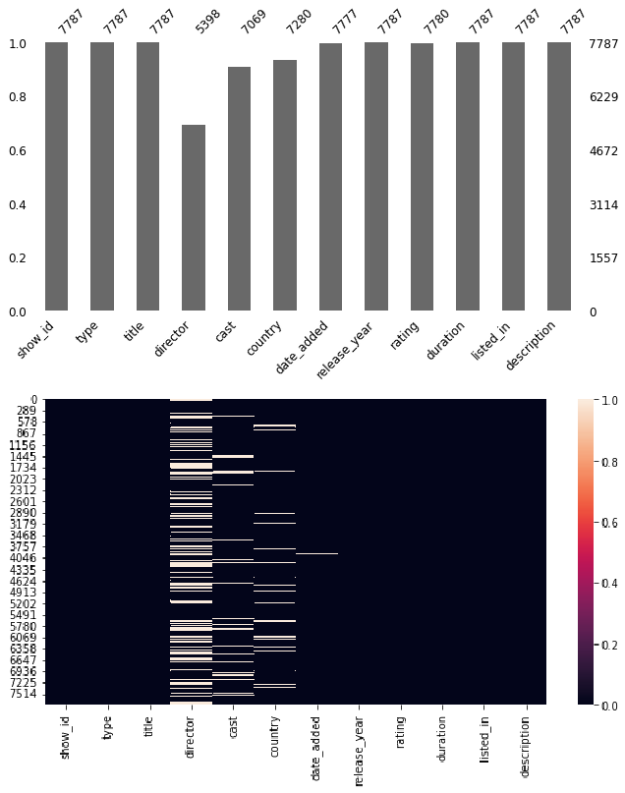
Null Values Treatment:
Null values present in the director, cast, country, date_added and rating column.
All the data that we have is related to each specific movie. So, we can't impute any null values with using any method. Also, we don't want to lose any data since the data size is small for that reason.
The null values in the director, cast, and country attributes can be replaced with 'empty string’.
Small amount of null value percentage present in rating and date_added column, if we drop these nan values it will not affect that much while building the model. So, we simply drop the nan value present in rating and date_added columns.

Slide 7
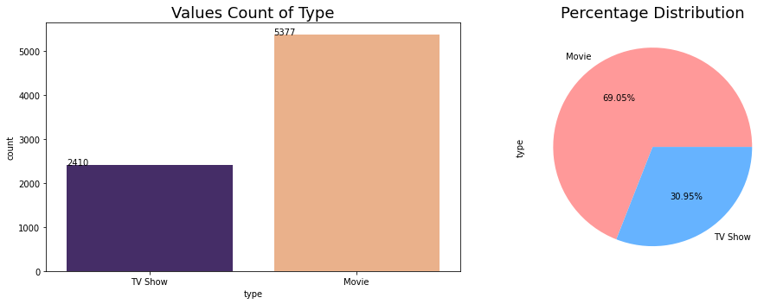
EXPLORATORY DATA ANALYSIS: (Type Column)
There are a greater number of count is Movie than TV Show.
69% of data belong from Movie class and 31% of data belong from TV shows

Slide 8
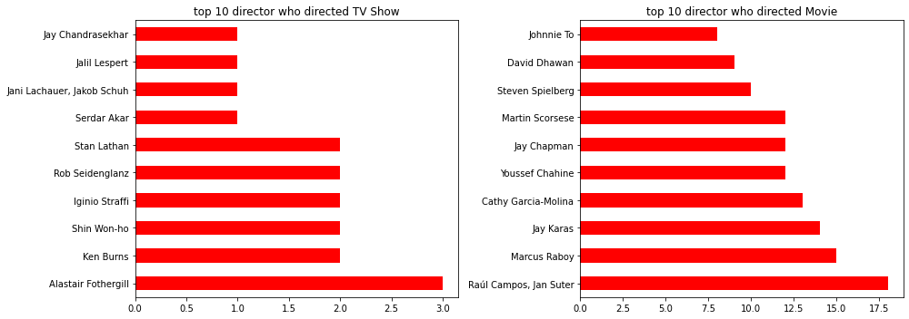
EXPLORATORY DATA ANALYSIS: (Director column)
Alstair Fothergill directed highest shows in data list which is 3.
Raul Campos and Jan Suter together have directed 18 movies, higher than anyone in the
dataset.

Slide 9
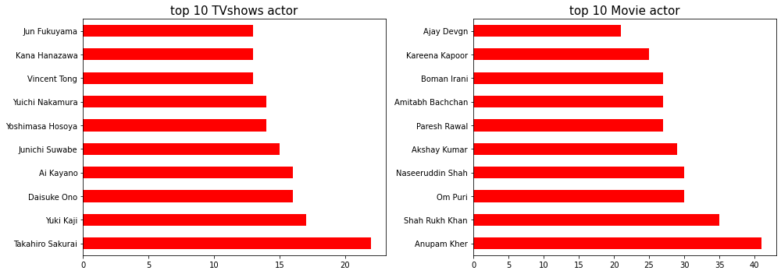
EXPLORATORY DATA ANALYSIS: (Cast column)
Anupam Kher, Shahrukh Khan, Om Puri play highest number of role in the movies.
Takahiro Sakurai, Yuki Kaji, Daisuke Ono play highest role in the TV shows

Slide 10
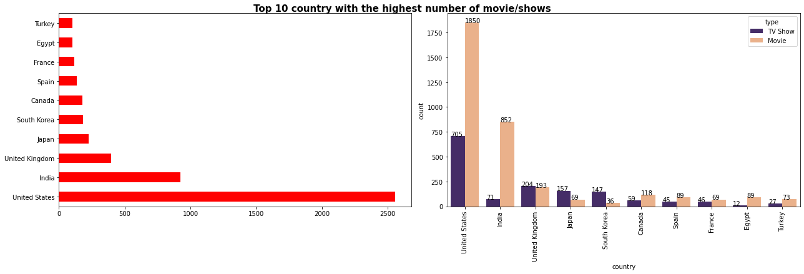
EXPLORATORY DATA ANALYSIS: (Country column)
The highest number of count were based out of the United State, followed by India and
United Kingdom.
In India and United State, a greater number of movie present compared to TV show.
Greater number of count in TV shows belong from South Korea and Japan.

Slide 11
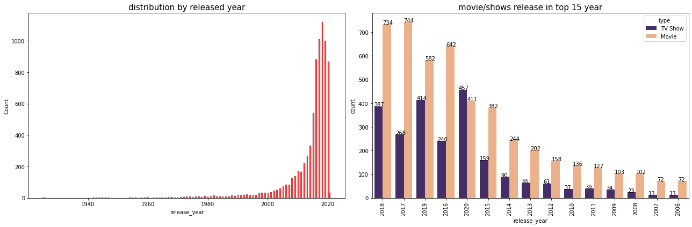
EXPLORATORY DATA ANALYSIS: (Release_Year column)
Netflix has greater number of new movies / TV shows than the old ones.
Highest number of movie/shows are released in Netflix in between 2015-2020 and highest number of count belong from 2018 year.

Slide 12
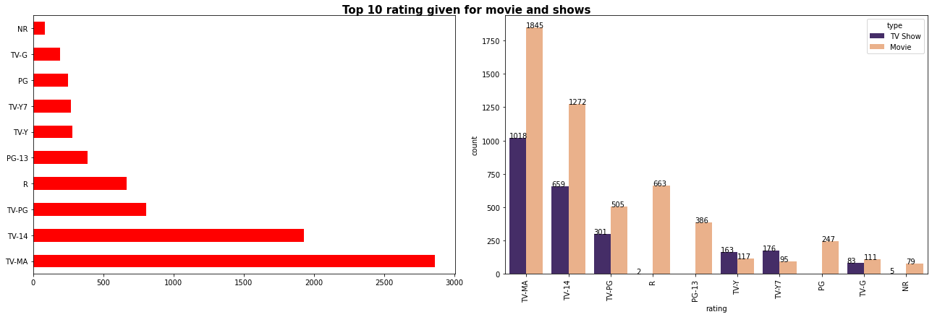
EXPLORATORY DATA ANALYSIS: (Rating column)
TV-MA : Mature Adults
R : Adults
PG-13 : Teens
TV-14 : Young Adults
TV-PG : Older Kids
NR : Adults
TV-G : Kids
TV-Y : Kids
TV-Y7 : Older Kids
PG : Older Kids
Most of the Movies and tv shows have rating of TV-MA (Mature Audience) then followed by TV-14 (younger audience).
Highest number of rating given for the movies it is obvious because of highest number of category belong from Movie class as we can seen in type column.

Slide 13
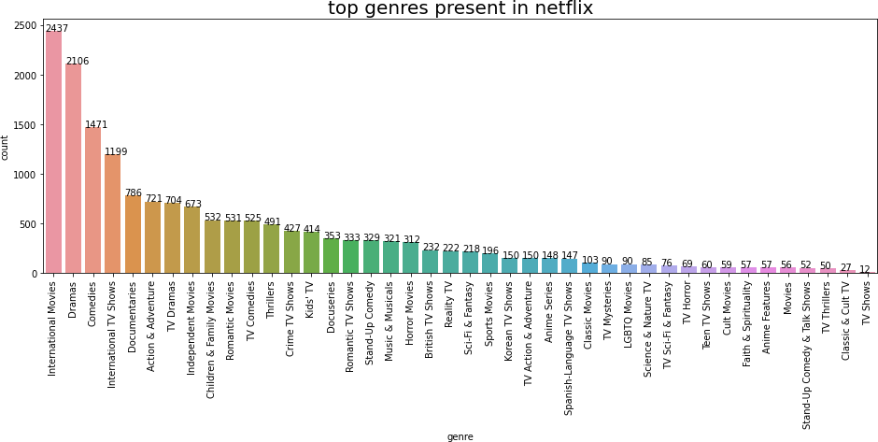
EXPLORATORY DATA ANALYSIS: (Listed_IN [genre] column)
Highest number of genre belong from International movies, Dramas, Comedies, respectively.
Least number of genre belong from Classic & Cult TV, TV Thriller, Stand-Up comedy and Talk
show

Slide 14
Modeling Approach:
Select the attributes based on which you want to cluster the shows
Text preprocessing: Remove all stop words and punctuation marks, convert all textual data to lowercase.
Stemming to generate a meaningful word out of corpus of words.
Tokenization of corpus and Word vectorization
Dimensionality reduction
Use different algorithms to cluster the movies, obtain the optimal number of clusters using different techniques
Build optimal number of clusters and visualize the contents of each cluster using word clouds.
Cluster:
We create one cluster column based on the following features:
Director
Cast
Country
Rating
Listed in (genres)
Description

Slide 15
Before clusters implementation we need to pre-process the data. So that we filtered data with following
steps:
Removing Stop words
Stop words are common words like “the”, “and” and “but” do not carry much meaning on their own and are
often seen as noise in the data.
Lowercasing words
Lowercasing the words can also reduce the size of the vocabulary, which can make it easier to work with larger texts or texts in languages with a high number of inflected forms.
Removing Punctuation
Punctuation marks like periods, commas, and exclamation points can add noise to the data and can sometimes be treated as separate tokens, which can affect the performance of NLP models.
Stemming
used Snowball Stemmer to generate a meaningful word out of corpus of words.
For example, the words "run," "runs," "ran," and "running" are all different inflected forms of the same word "run," and a stemmer can reduce them all to the base form "run."
Tokenization of corpus and Word vectorization – TFIDF
1. This is important in NLP tasks because most machine learning models expect numerical input and cannot work with raw text data directly. Word vectorization allows you to input the words into a machine learning model in a way that preserves the meaning and context of the words.
Dimensionality reduction – PCA
Dimensionality reduction is the process of reducing the number of features or dimensions in a dataset while preserving as much information as possible. As high-dimensional datasets can be difficult to work with and can sometimes suffer from the curse of dimensionality.

Slide 16
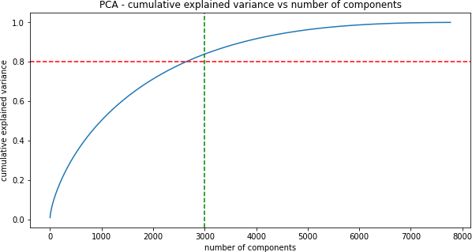
Principle Component Analysis:
As you can see that 100% of the variance is explained by about ~7500 components.
Also, more than 80% of the variance is explained just by 3000 components.
Hence to simplify the model, and reduce dimensionality, we take top 3000 components, which will still be able to capture more than 80% of variance

Slide 17
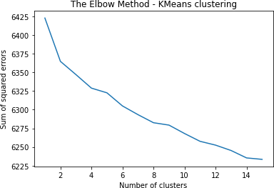
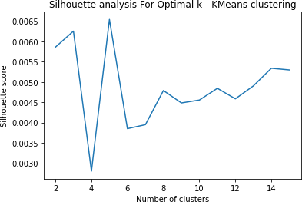
K-Means Clustering:
Visualizing the elbow curve and Silhouette score to decide on the optimal number of clusters for K- means clustering algorithm.
The sum of squared errors between each point and the centroid in a cluster decreases with the increase in the number of clusters
The highest Silhouette score is obtained for 5 clusters.
Building 5 clusters using the k-means clustering algorithm

Slide 18
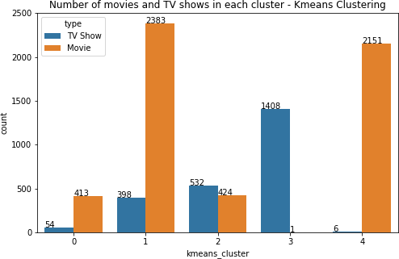
K-Means clusters:
Successfully built 5 clusters using the k-means clustering algorithm.
In cluster 0, 1 & 4 highest number of count belong from Movie class.
Cluster 3 build on TV shows.

Slide 19
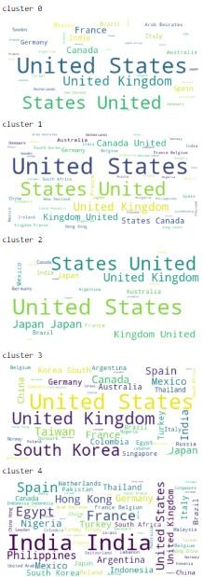
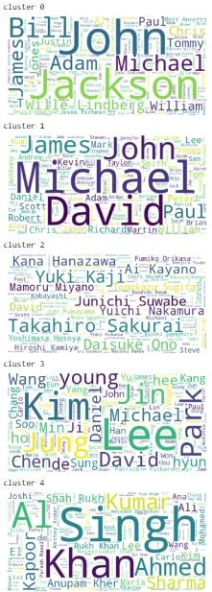
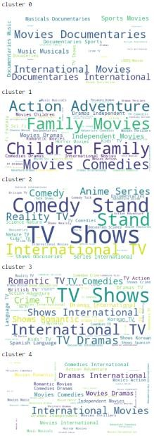
Word cloud for country
Word cloud for cast
Word cloud for genre

Slide 20
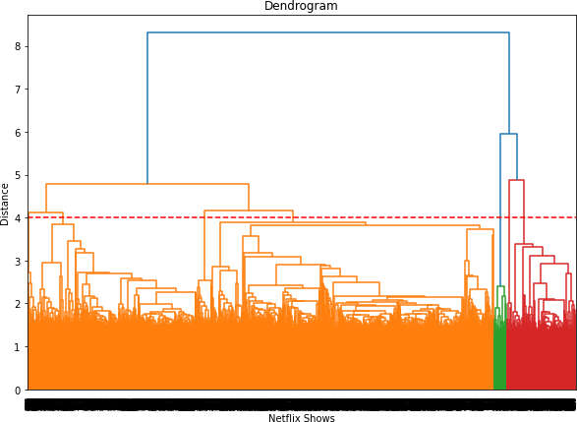
Agglomerative Hierarchical Clustering:
Visualizing the dendrogram to decide on the optimal number of clusters for the agglomerative (hierarchical) clustering algorithm.
At a distance of 4 units, 7 clusters can be built using the agglomerative clustering algorithm.

Slide 21
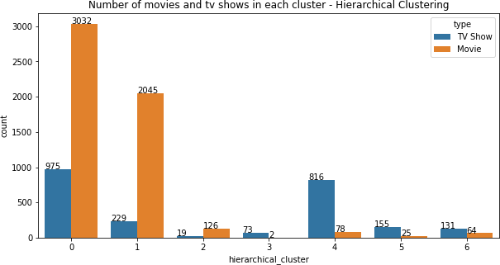
Agglomerative Hierarchical clusters:
Successfully built 7 clusters using the Agglomerative (hierarchical) clustering algorithm.
Highest number of datapoint build on cluster 0 & 1.

Slide 22
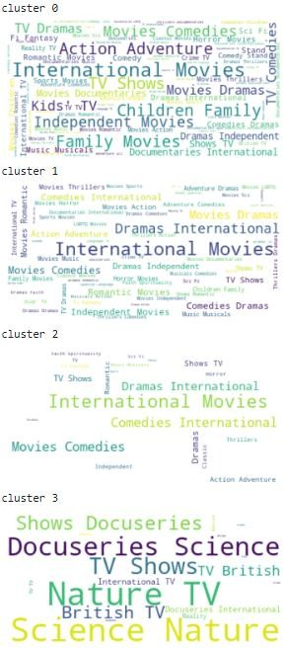
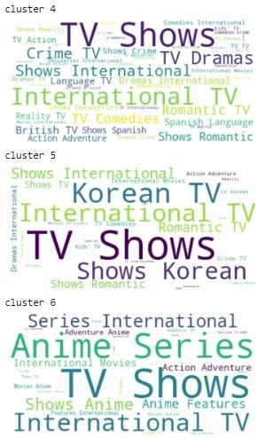
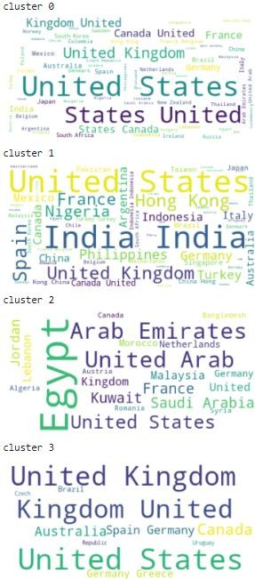
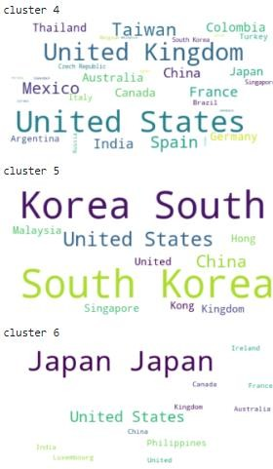
Word cloud for genre
Word cloud for country

Slide 23
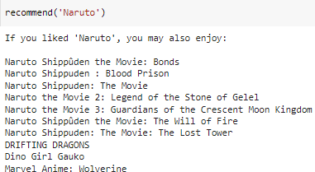
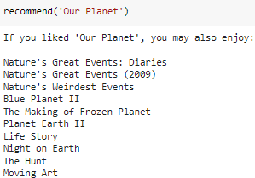
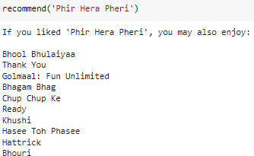
Recommendation System:
We can build a simple content-based recommender system based on the similarity of the
movie/shows.
If a person has watched a show on Netflix, the recommender system must be able to recommend a list of similar shows that s/he likes.
To get the similarity score of the shows, we can use cosine similarity.
The similarity between two vectors (A and B) is calculated by taking the dot product of the two vectors and dividing it by the magnitude value. We can simply say that the CS score of two vectors increases as the angle between them decreases.

Slide 24
CONCLUSION:
In this project, we worked on a text clustering problem wherein we had to classify/group the Netflix shows into certain clusters such that the shows within a cluster are similar to each other and the shows in different clusters are dissimilar to each other.
The dataset contained about 7787 records, and 11 attributes. We began by dealing with the dataset's missing values and doing exploratory data analysis (EDA).
It was decided to cluster the data based on the attributes: director, cast, country, genre, rating and description. The values in these attributes were tokenized, preprocessed, and then vectorized using TFIDF vectorizer.
Through TFIDF Vectorization, we created a total of 10000 attributes.
We used Principal Component Analysis (PCA) to handle the curse of dimensionality. 3000 components were
able to capture more than 80% of variance, and hence, the number of components were restricted to 3000.
We first built clusters using the K-Means Clustering algorithm, and the optimal number of clusters came out to be 5. This was obtained through the elbow method and Silhouette score analysis.
Then clusters were built using the Agglomerative clustering algorithm, and the optimal number of clusters came out to be 7. This was obtained after visualizing the dendrogram.
A content-based recommender system was built using the similarity matrix obtained after using cosine similarity. This recommender system will make 10 recommendations to the user based on the type of show they watched.

Slide 25
Thank You

